Slide 1

MEC135:BASICS OF MECHANICAL ENGINEERING

Slide 2
WHAT IS MECHANICS?
Mechanics can be defined as that science which describes and predicts the conditions of rest or motion of bodies under the action of forces.
It is divided into three parts:
Mechanics of rigid bodies,
Mechanics of deformable bodies, and
Mechanics of fluids.

Slide 3
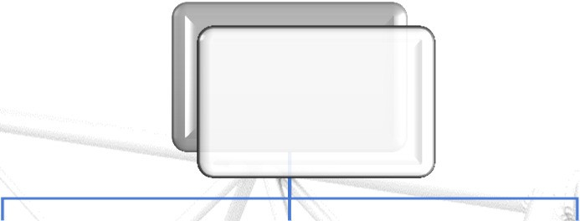






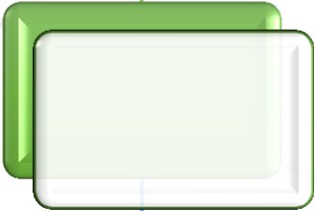





Mechanics
The mechanics of rigid bodies is subdivided into
Statics and
Dynamics
Mechanics
Rigid bodies
Deformable bodies
Fluids
Statics
Dynamics
Compressible
In- Compressible
Kinetics
Kinematics

Slide 4

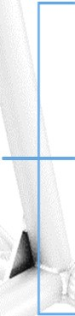




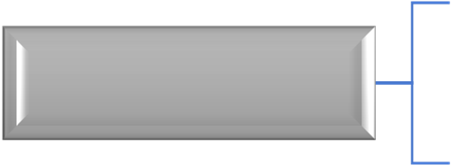






Rigid Body Mechanics
Statics: deals with equilibrium of bodies under action of forces (bodies may be either at rest or move with a constant velocity).
Dynamics: deals with motion of bodies (accelerated
motion).
Displacement
Kinematics
Velocity
Statics
Rigid bodies
Acceleration
Dynamics
Force/Torque
Kinetics
Energy/momentum

Slide 5
Force
Force represents the action of one body on another.
It changes (or) tends to change the state of rest or uniform motion of a body
A force is characterized by its point of application, magnitude, and direction, i.e., a force is a vector. (Free vector, Sliding Vector, Fixed Vector)

Slide 6
Particle & Rigid body
Particle - a very small amount of matter which may be assumed to occupy a single point in space.
Rigid body - a combination of a large number of particles occupying fixed positions with respect to each other.

Slide 7
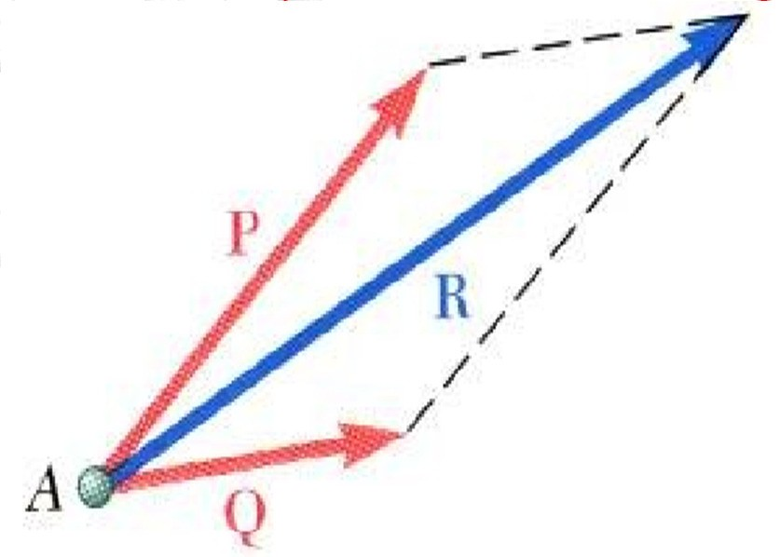
Parallelogram Law for the Addition of Forces
Two forces acting on a particle may be replaced by a single force, called their resultant.
It is obtained by drawing the diagonal of the parallelogram which has sides equal to the given forces.

Slide 8
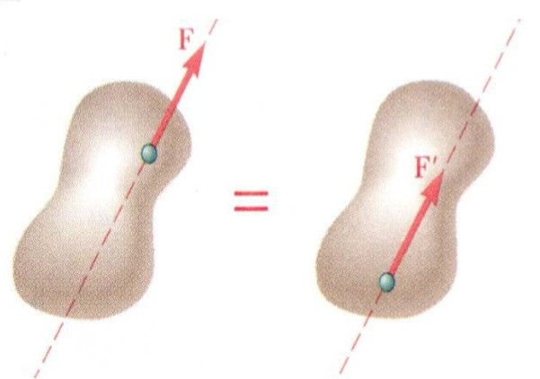
Principle of Transmissibility
The conditions of equilibrium or of motion of a rigid
body will remain unchanged if a force acting at a
given point of the rigid body is replaced by a force of the same magnitude and same direction, but acting at a different point, provided that the two forces have the same line of action.

Slide 9
Method of Problem Solution
Problem Statement:
Includes given data, specification of what is to be determined, and a figure showing all quantities involved.
Free-Body Diagrams
Create separate diagrams for each of the bodies involved with a clear indication of all forces acting on each body.
Fundamental Principles
The six fundamental principles are applied to express the conditions of rest or motion of each body. The rules of algebra are applied to solve the equations for the unknown quantities.

Slide 10
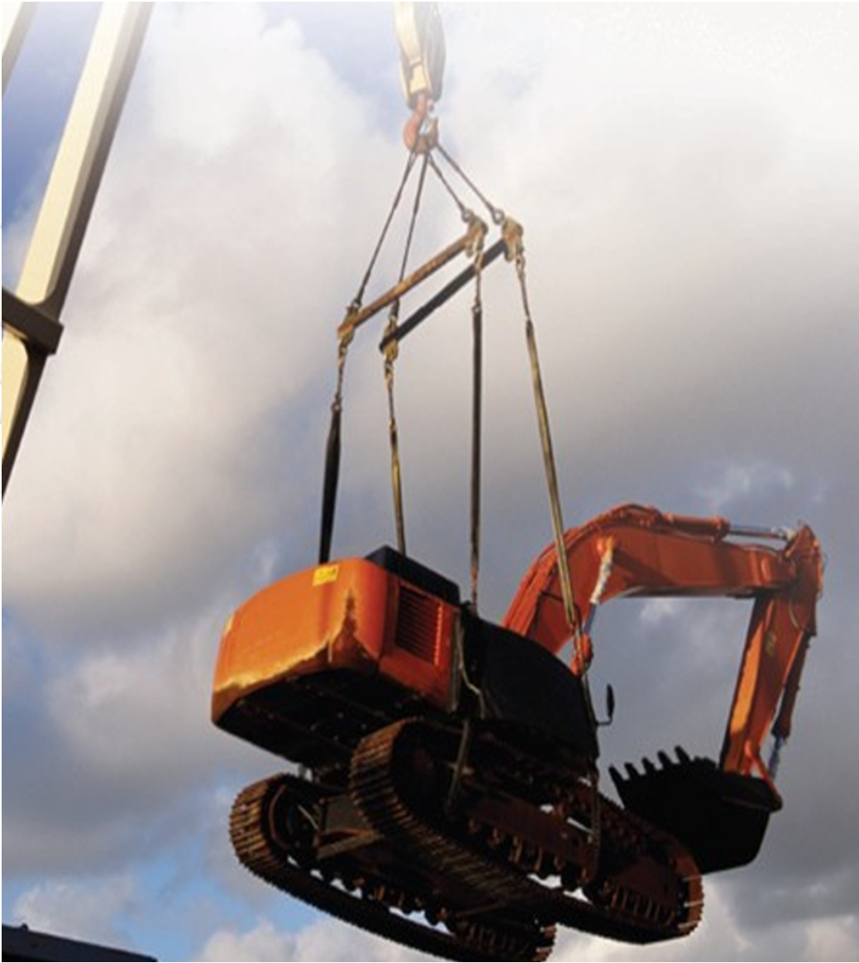
Statics of Particles

Slide 11
Statics of Particles
Particle: Size and shape of the body are neglected, but not the mass.
Forces in a plane
Resultant of several concurrent forces (Polygon law) Resolution of a force into components
Rectangular components of a force : Unit vectors
Addition of forces by summing X and Y components Equilibrium of a Particle

Slide 12
Forces in a plane
A force represents the action of one body on another and is generally characterized by
its point of application,
its magnitude, and
its direction
Unit: Newton (N)
1 Newton is defined as the force acceleration of 1 m/s² to a mass of 1 kg.
which gives an

Slide 13

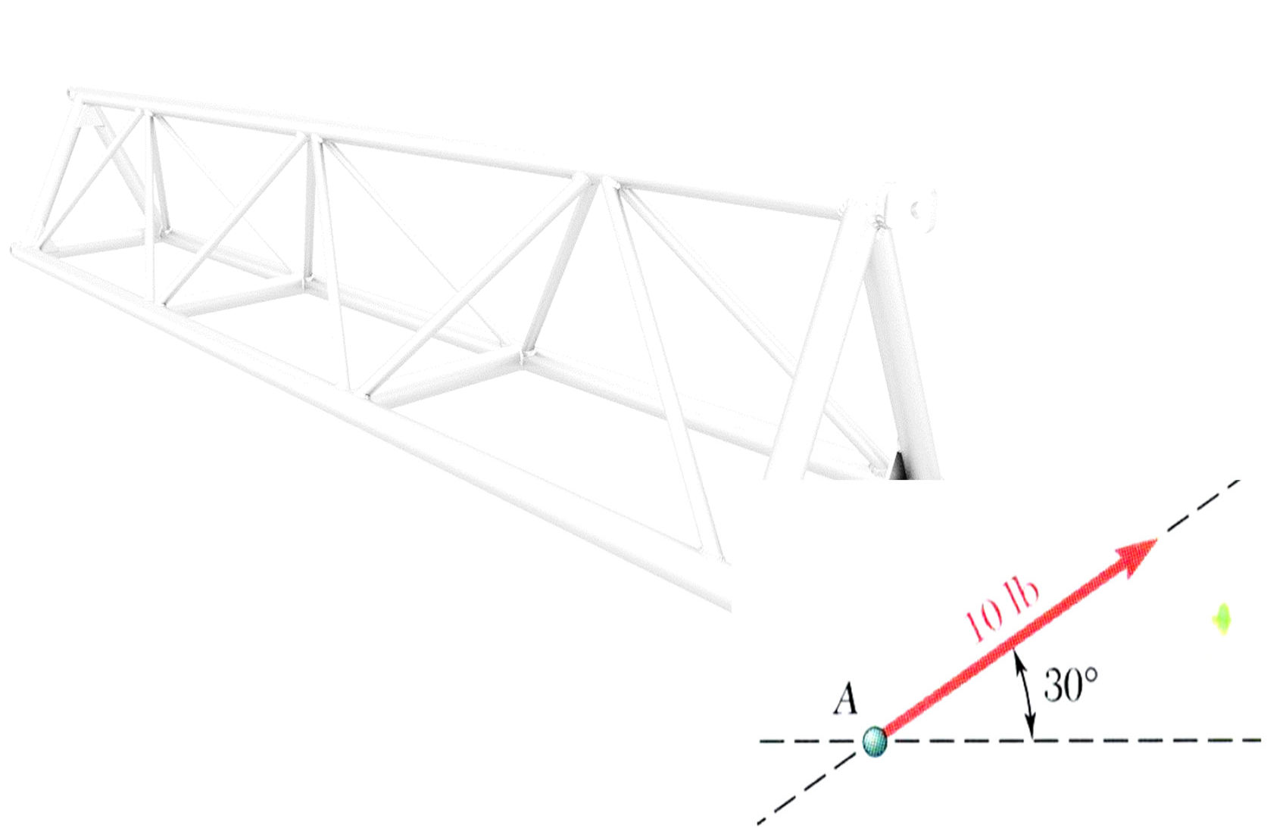
Forces
Concentrated force or a point force: it is the force acting on a very small area.
Distributed force: force distributed over a length or an area or a volume.
Line of action of force: Direction along a straight line through its point of application, in which the force tends to move a body to which it is applied.
Graphical representation of force

Slide 14
System of forces
When several forces of various magnitude and direction act upon a body they are said to form system of forces.
Classification of system of forces: Classified as per orientation of line of action of forces.
Concurrent force system: acts on a particle or rigid body
Parallel and General force system: acts mainly on rigid bodies

Slide 15
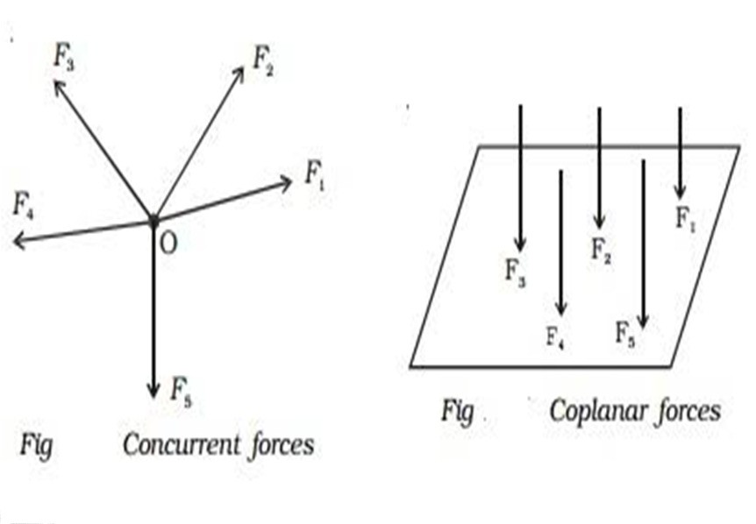
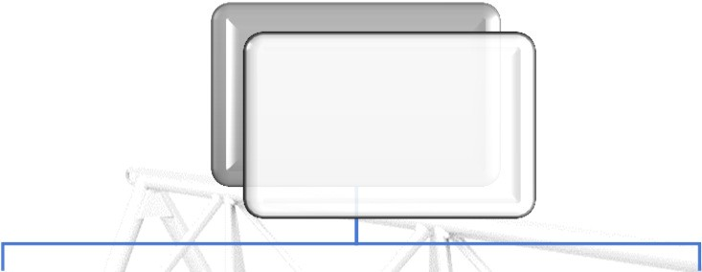








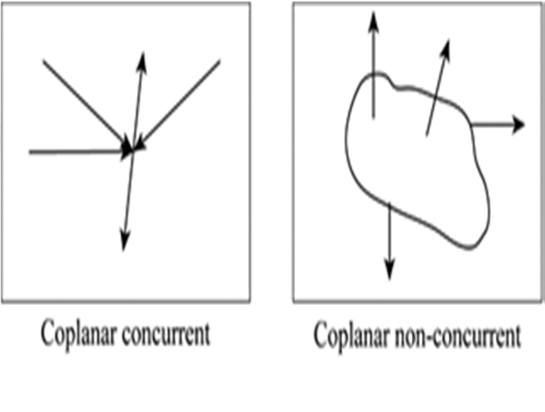






System of forces
System of Forces
Coplanar (in Plane/ 2-D)
Non-Coplanar (Space/ 3-D)
Concurrent
Non- Concurrent
Concurrent
Non- Concurrent
Parallel
General
Parallel
General

Slide 16

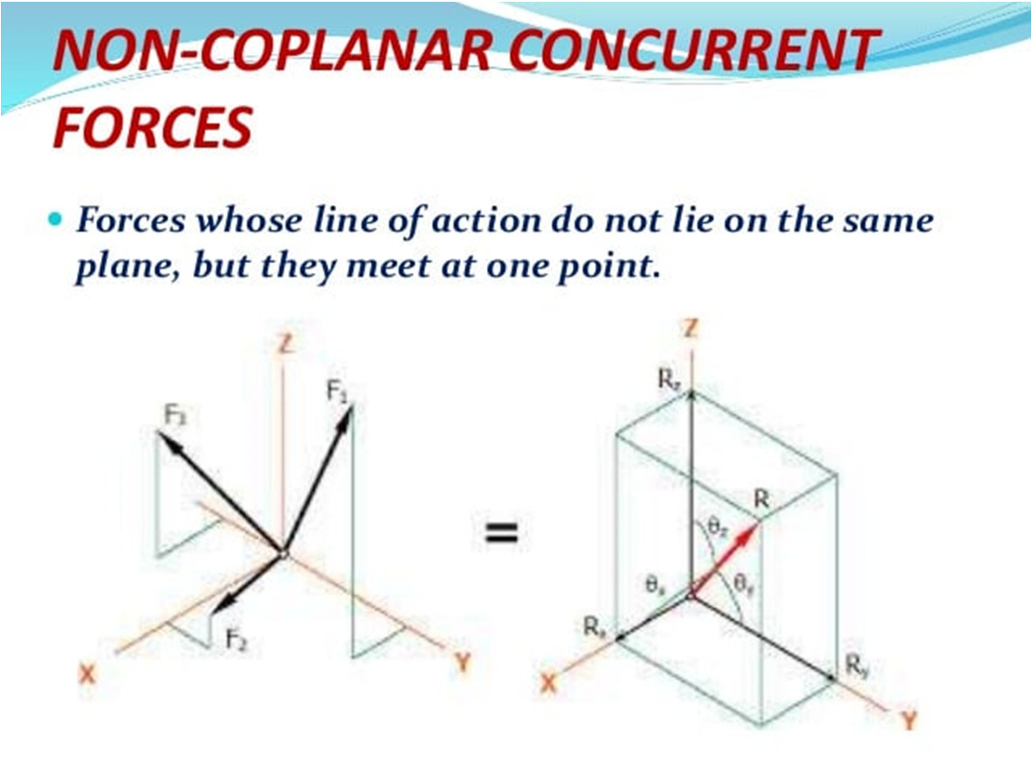
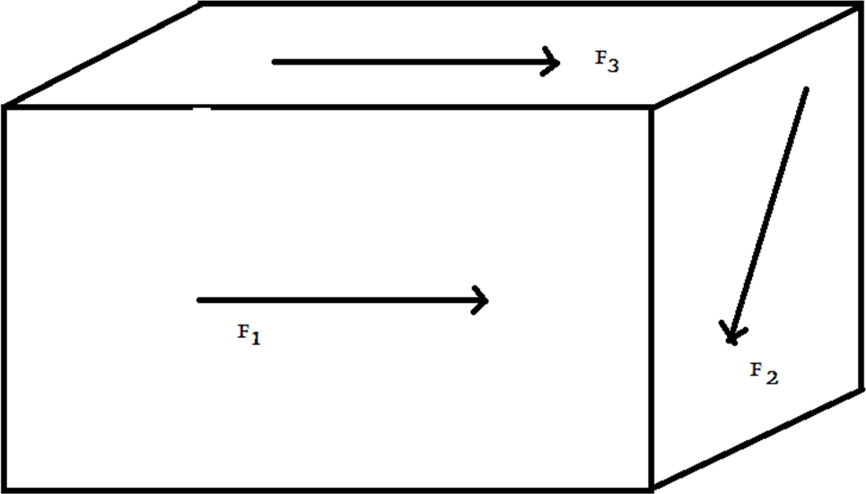
System of forces
Non-coplanar non concurrent forces

Slide 17
Coplanar concurrent forces
When all forces are acting in the same plane, they are called coplanar whereas when forces act at the same time and at the same point, they are called concurrent/forces.

Slide 18
Scalar & Vector
Scalar
Has magnitude and no associated direction
Volume, Time, Mass, Speed, Density & Temperature.
Vector
Has magnitude and direction
Force, Moment, Velocity & Acceleration.

Slide 19
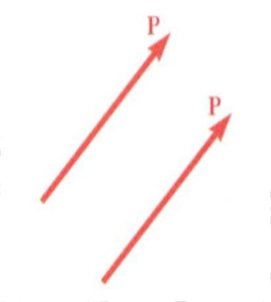
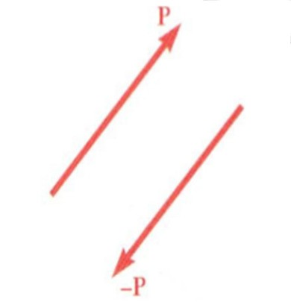
Vector classification
Equal vectors have the direction.
same magnitude and
Negative vector of a given vector has the same magnitude and the opposite direction.

Slide 20
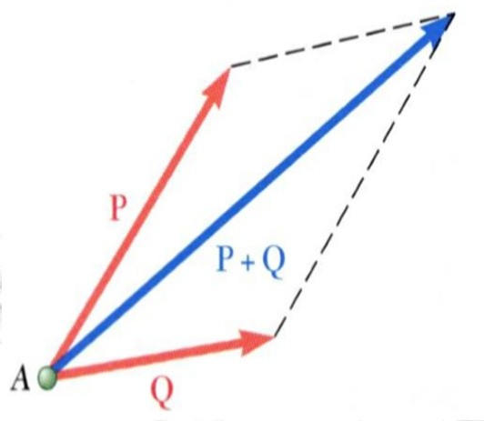
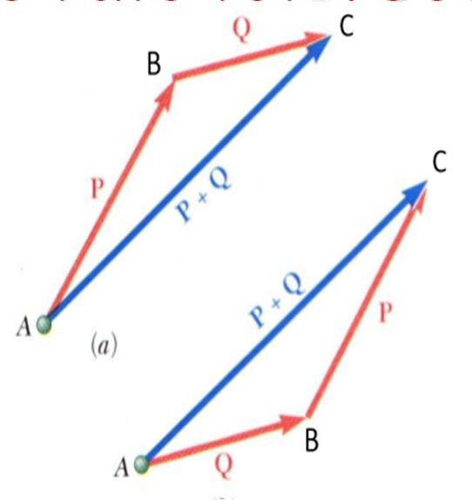
Addition of Vectors
Parallelogram rule for vector addition
Triangle rule for vector addition

Slide 21
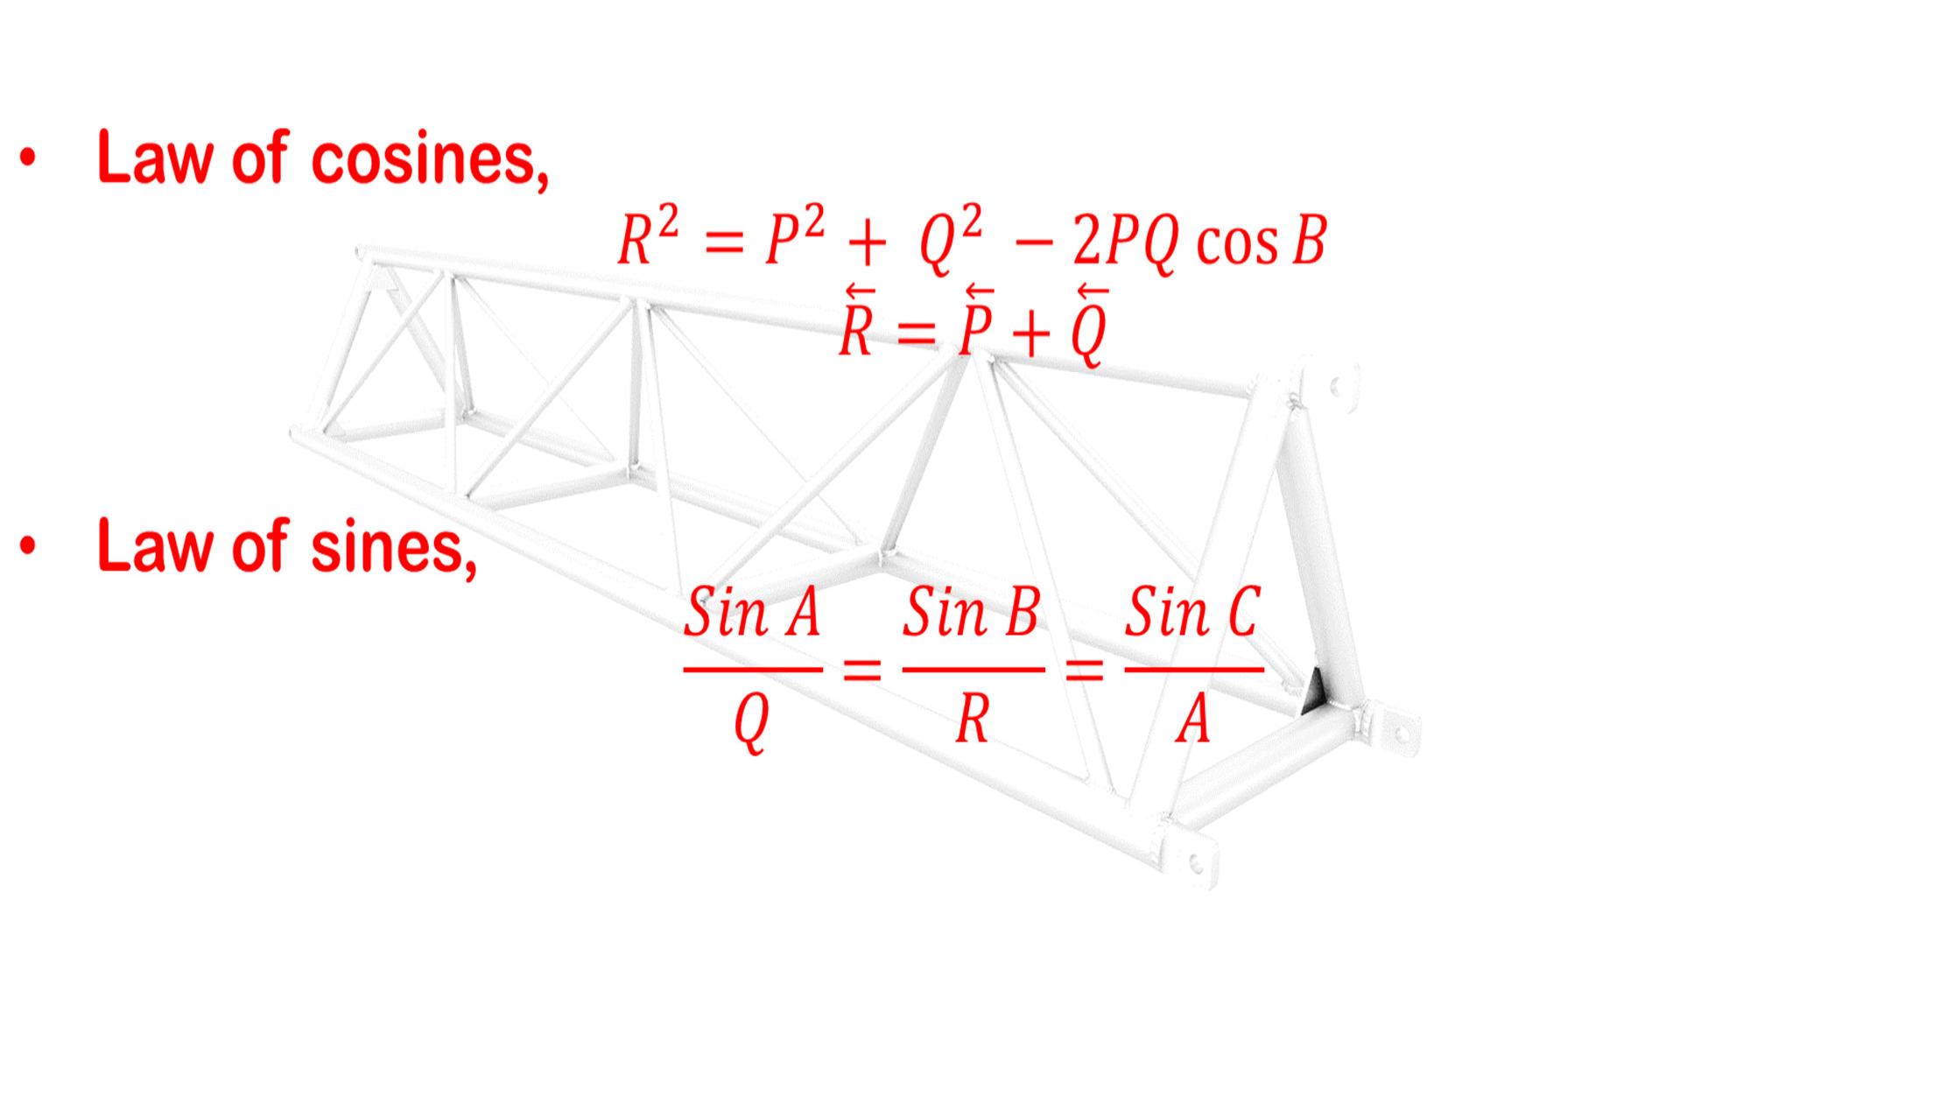
Addition of Vectors

Slide 22
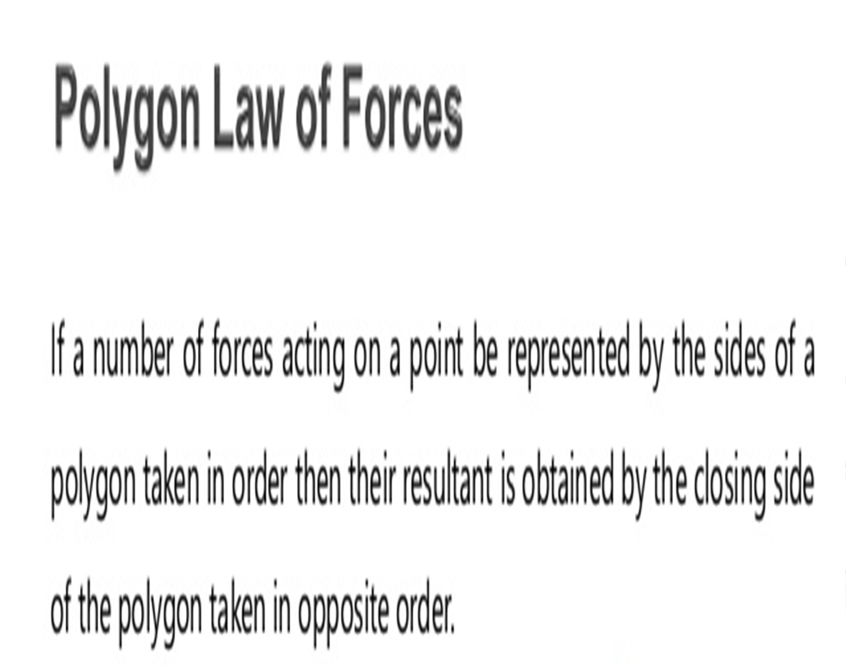
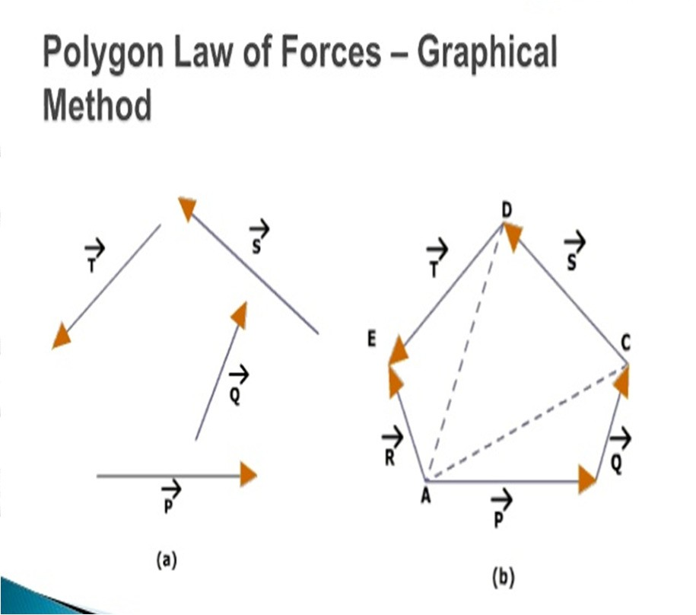
Addition of Vectors

Slide 23
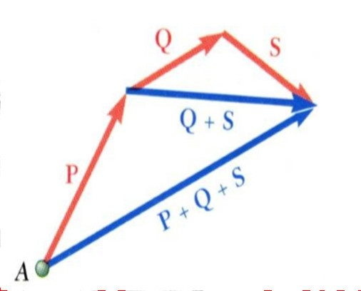
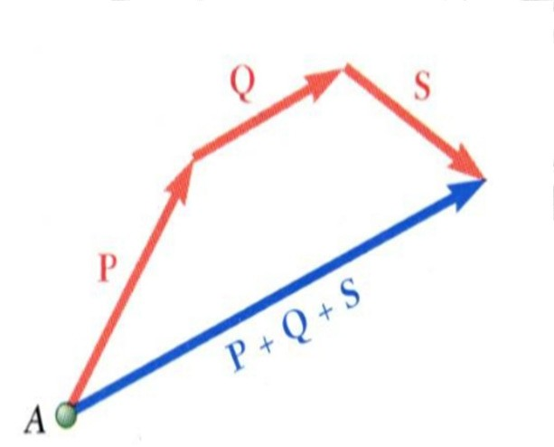
Addition of Vectors
Addition of three or more vectors through repeated application of the triangle rule.
The polygon rule for the addition of three or more vectors.

Slide 24
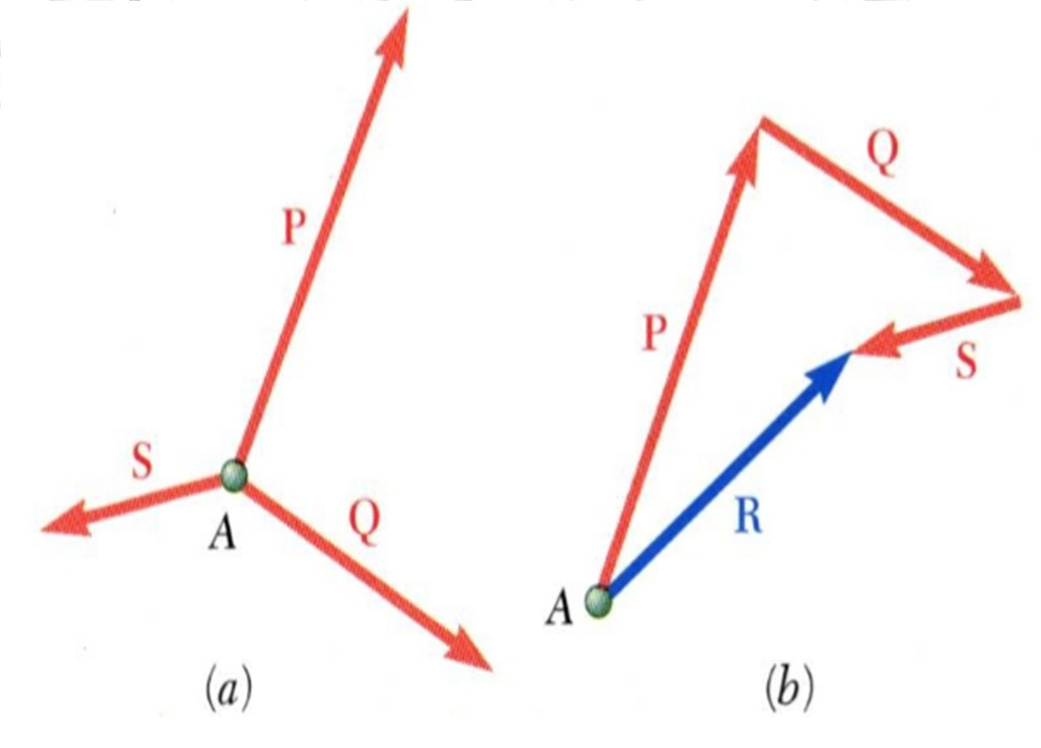
Resultant of Several Concurrent Forces
Concurrent forces: set of forces which all pass through the same point.
A set of concurrent forces applied to a particle may be replaced by a single resultant force which is the vector sum of the applied forces.

Slide 25
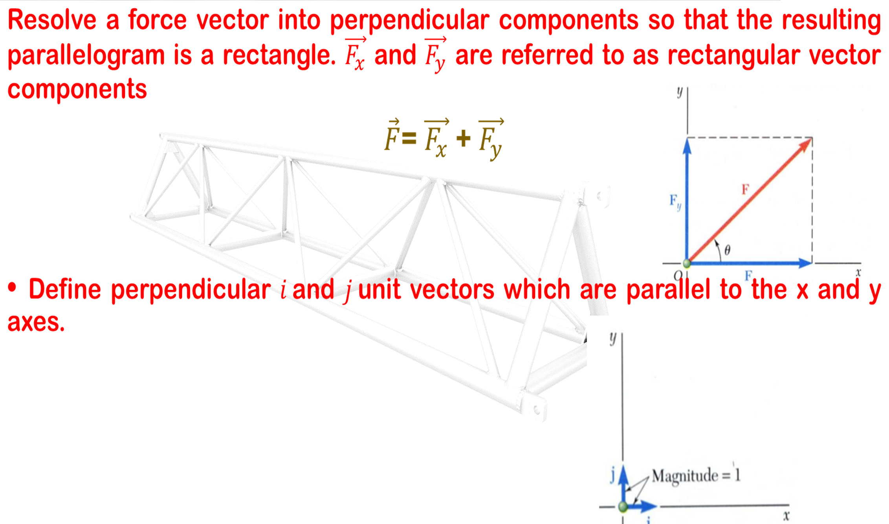
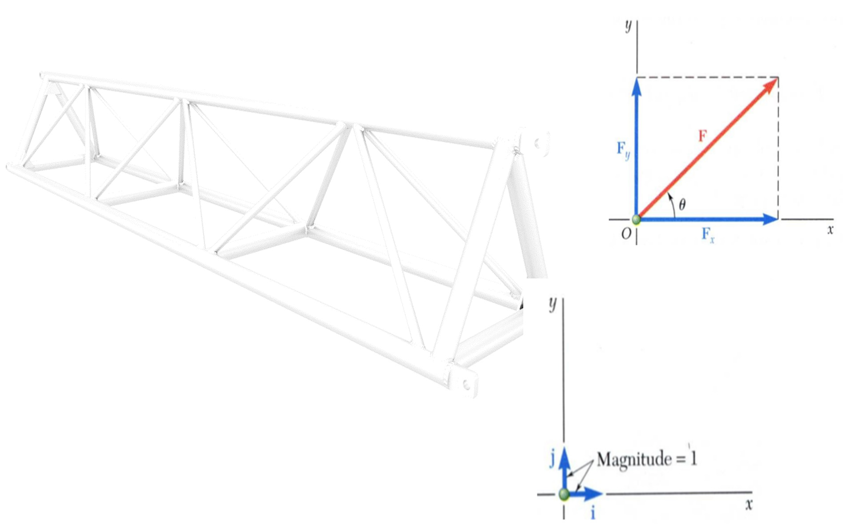
Rectangular Components of a Force:
Unit Vectors

Slide 26
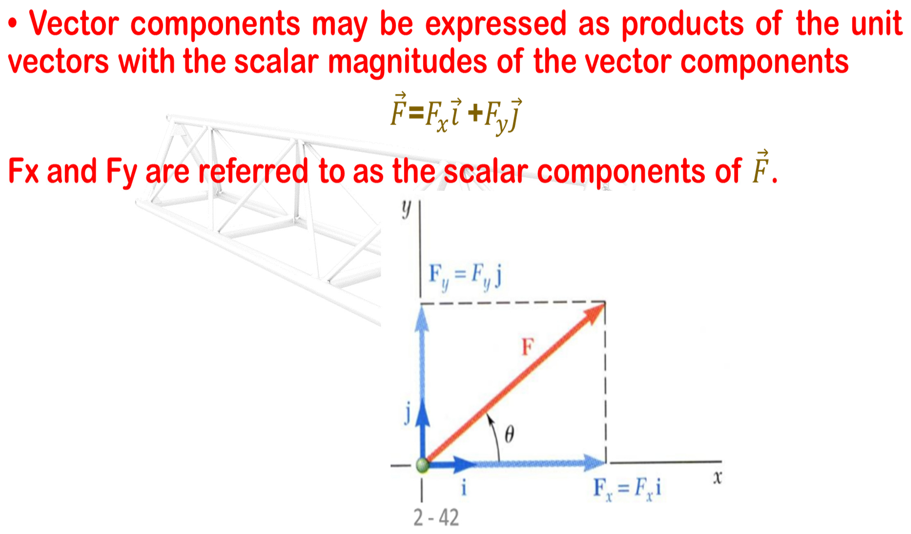
Rectangular Components of a Force:
Unit Vectors

Slide 27
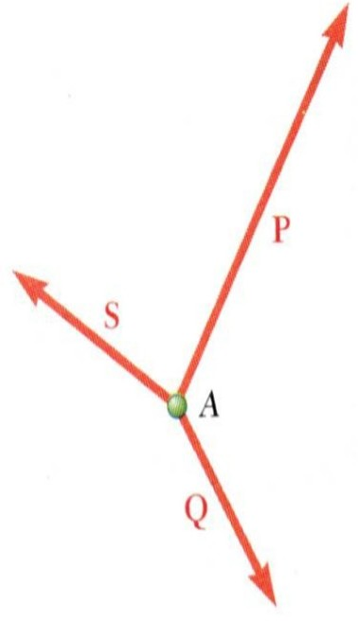
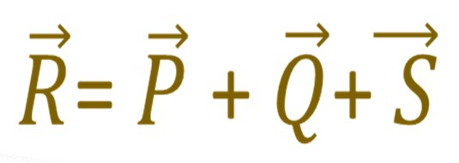
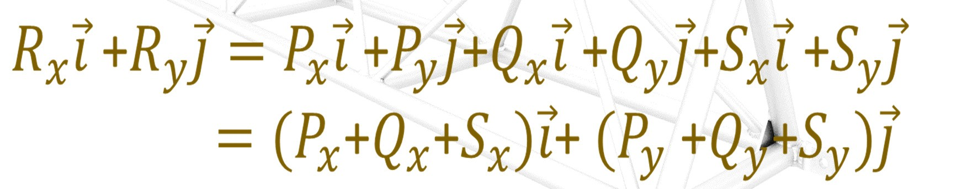
Addition of Forces by Summing Components
To find the resultant of 3 or more concurrent forces
Resolve each force into rectangular components
The scalar components of the resultant are equal to the sum of the corresponding scalar components of the given forces

Slide 28
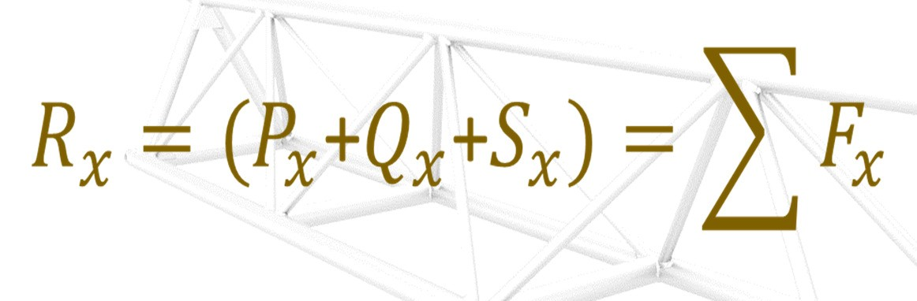
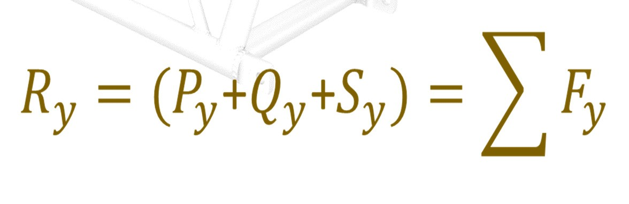
Scalar Components of resultant
The scalar components of the resultant are equal to the sum of the corresponding scalar components of the given forces.

Slide 29
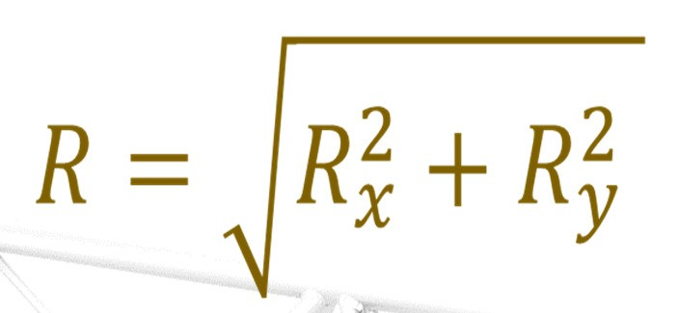
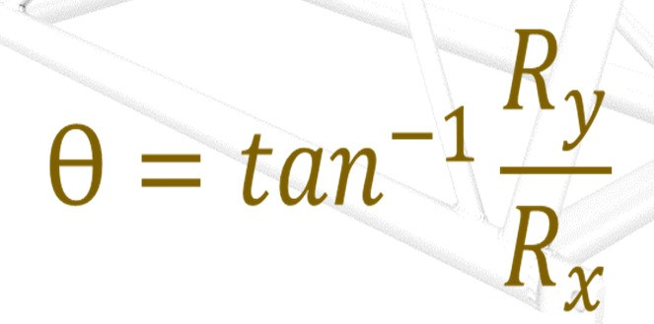
Magnitude and Direction of RESULTANT
Magnitude
Direction

Slide 30
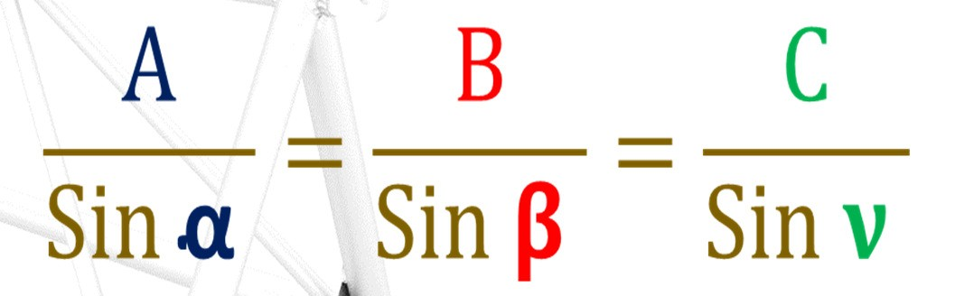
Lami’s Theorem
If the three forces
acting at a point are in
equilibrium, each force is proportional to the sine of
the angle between the other two force
C
B
α
𝛽
ν
A
While using Lami’s theorem, all the three forces should be either directed away or all directed towards the point of concurrence

Slide 31
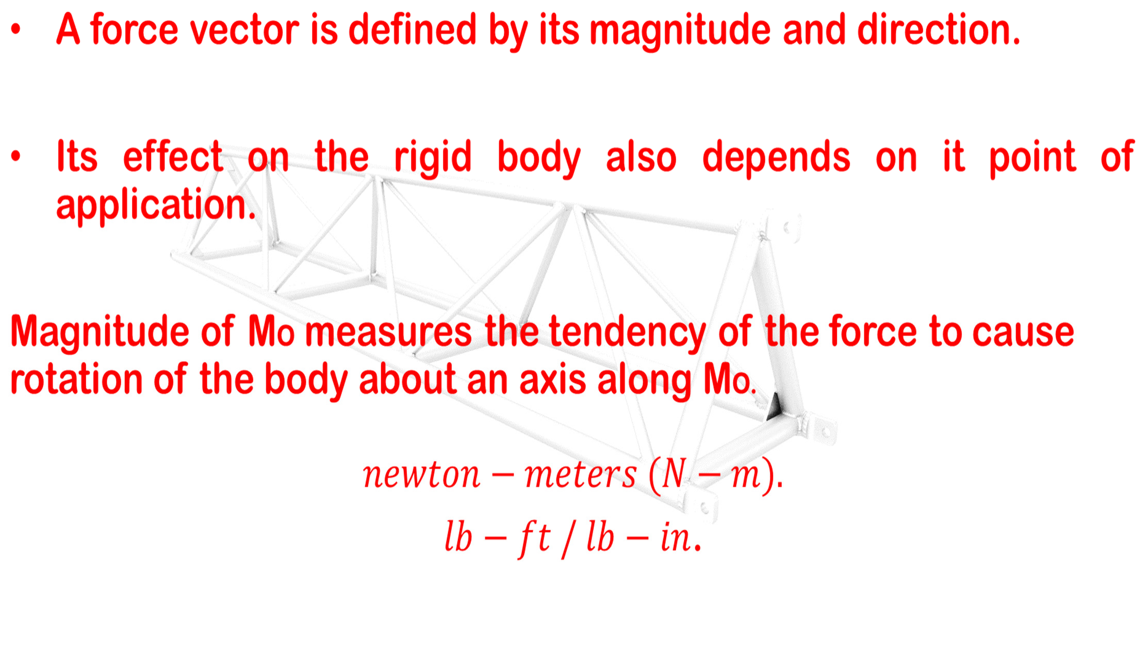
Moment of a Force About a Point

Slide 32
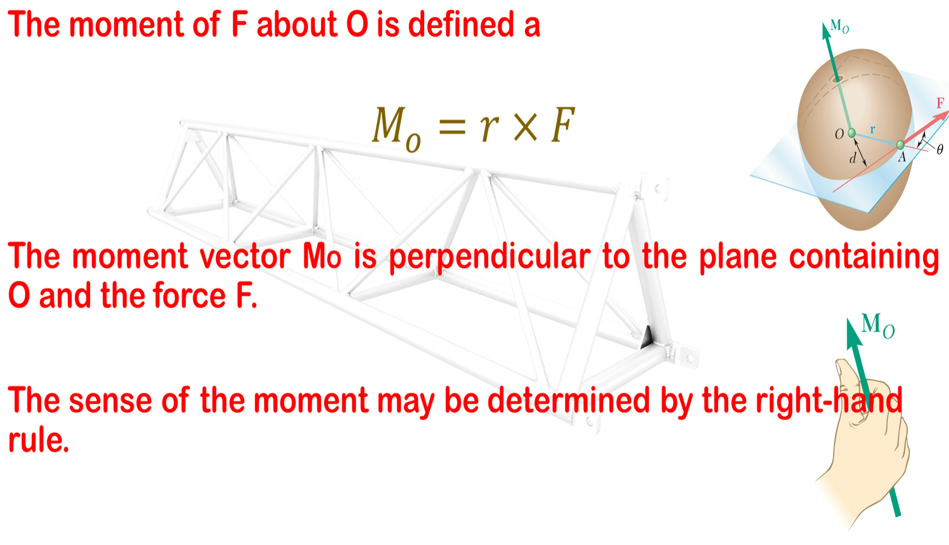
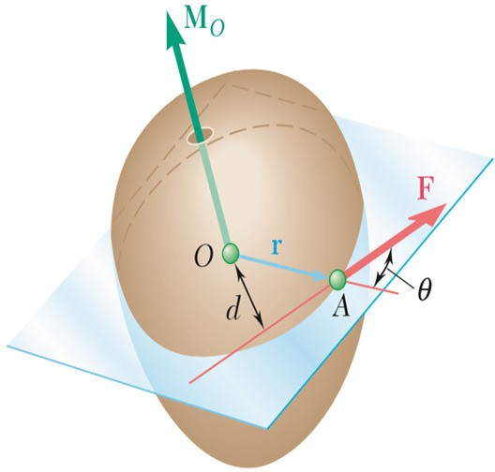
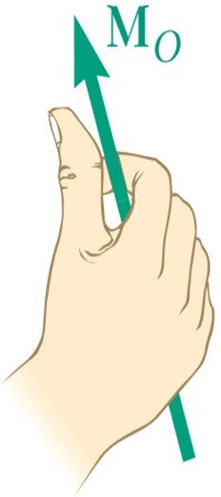
Moment

Slide 33
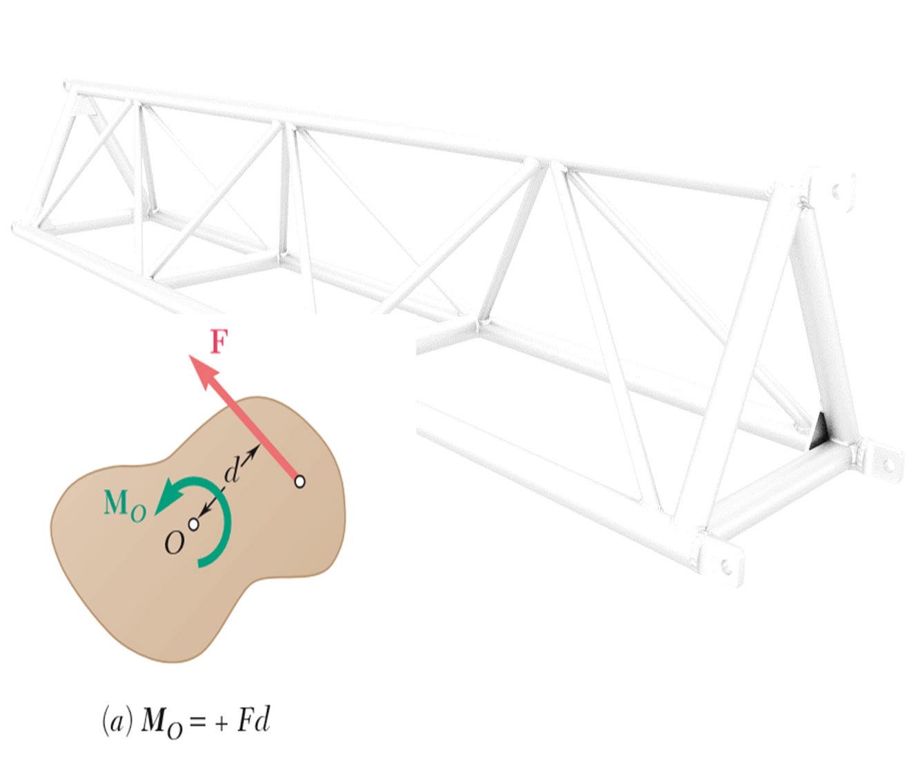
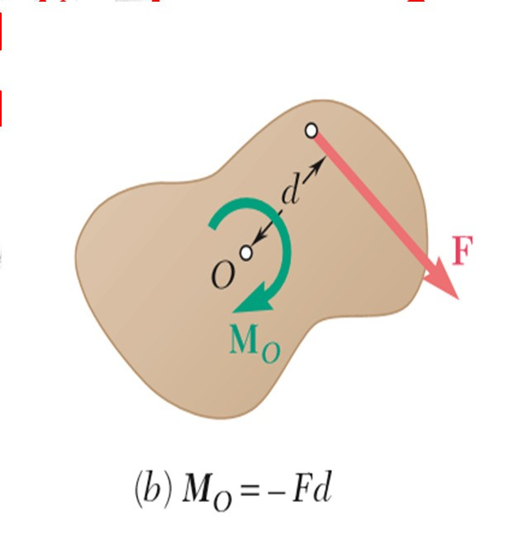
Moment in Two Dimensional System
If the force tends to If the force
tends to
rotate the structure rotate the
structure
counterclockwise, the clockwise, the sense of sense of the moment the moment vector is
vector is out of the into the plane of the
the the
plane of the structure structure and
and the magnitude of magnitude of
the moment is positive. moment is negative

Slide 34
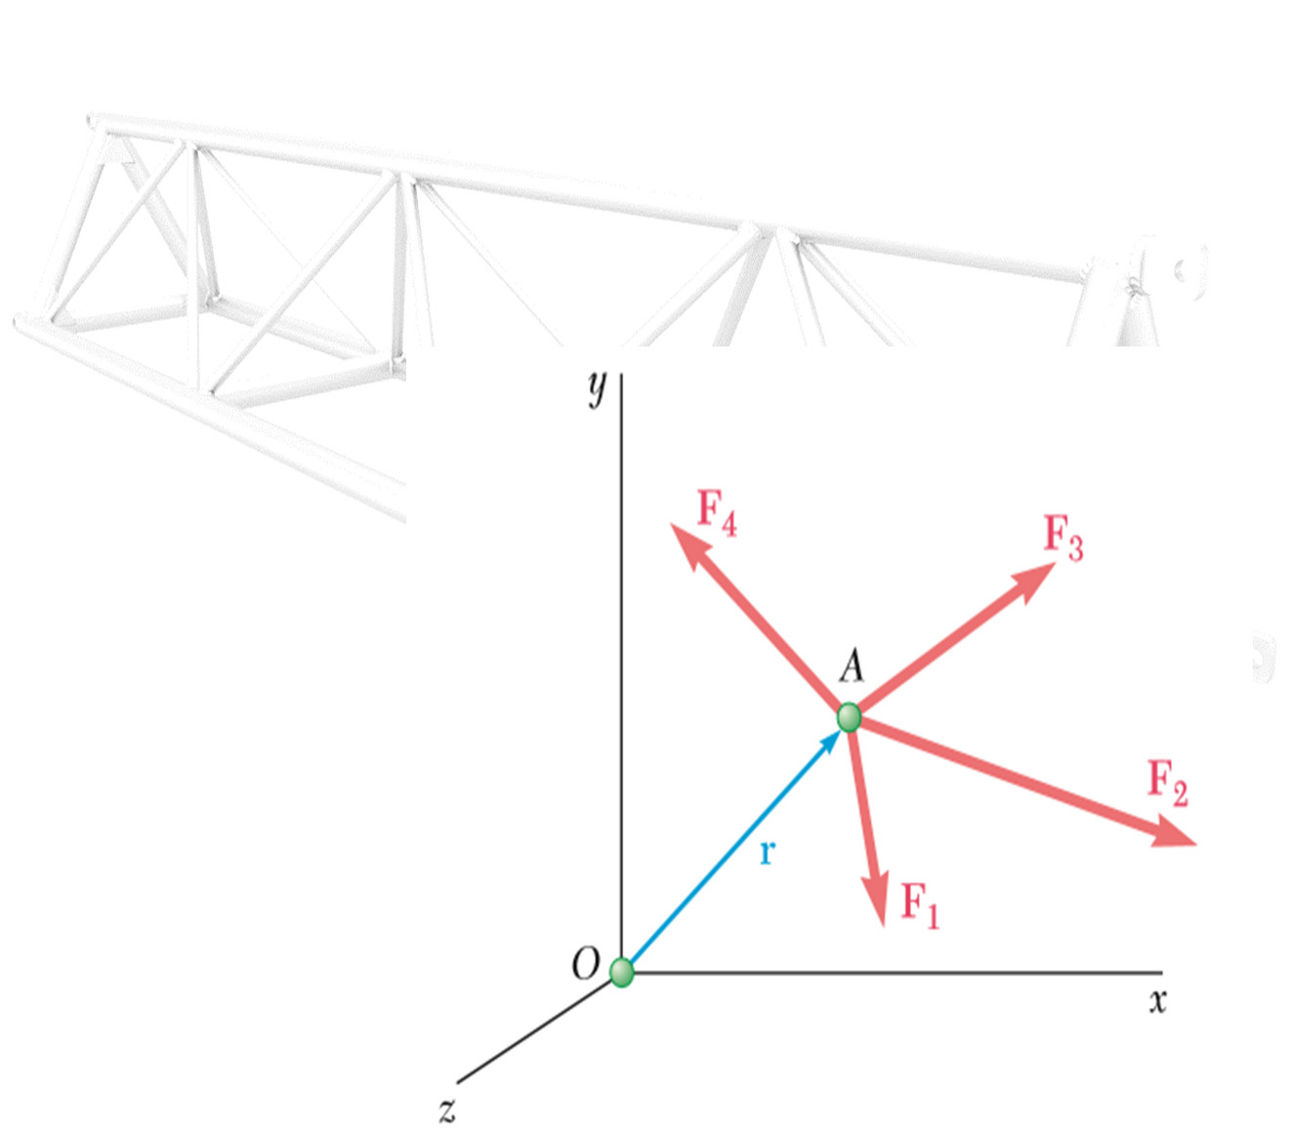
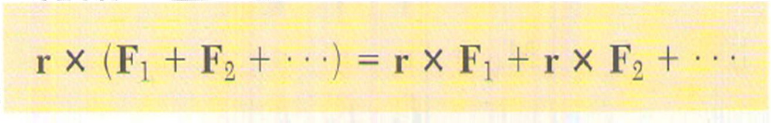
Varignon’s Theorem
The moment about a given point O of the resultant of several concurrent forces is equal to the sum of the moments of the various forces about the same point O.
French Varignon long
mathematician (1654–1722)
before
the vector
introduction of algebra, is known
as
Varignon’s theorem.

Slide 35
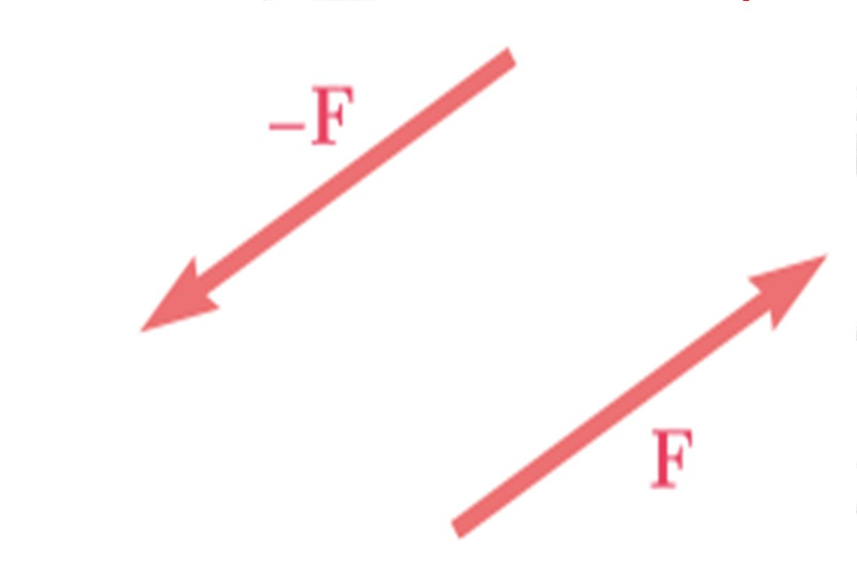
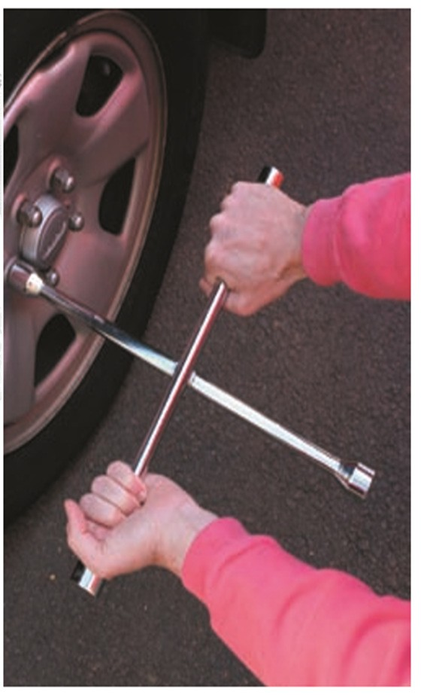
Couple
Two forces F and -F having the same magnitude, parallel lines of action, and opposite sense are said to
form a couple.
The sum of the components of the two forces in any direction is zero.
The sum of the moments of the two forces about a given point, however, is not zero.

Slide 36
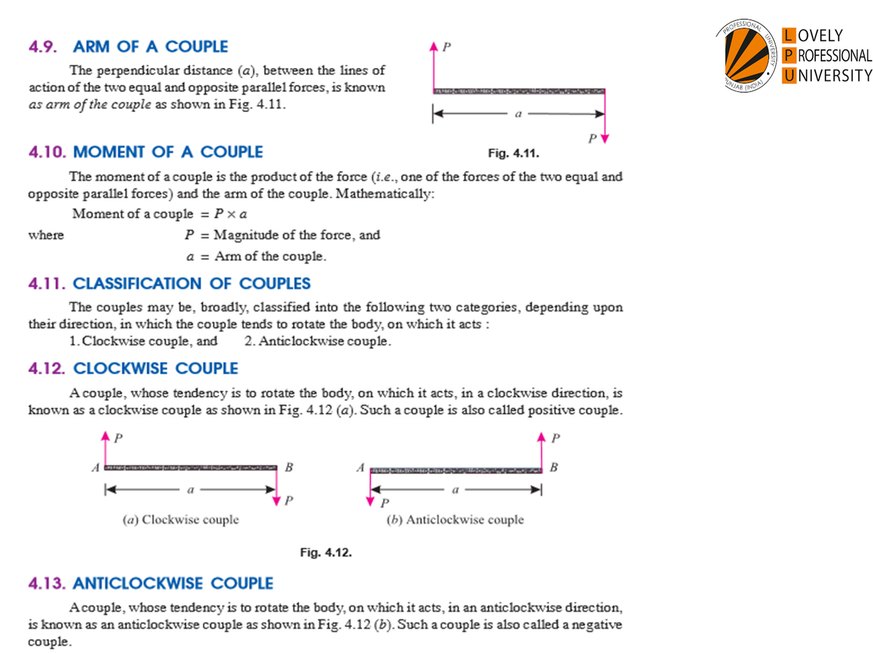

Slide 37
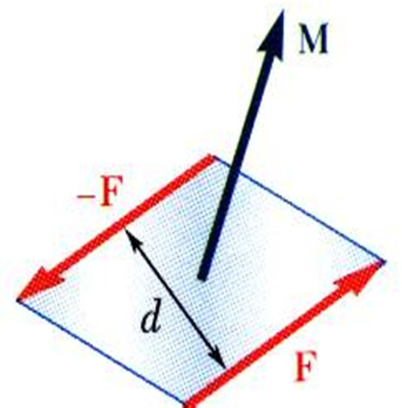
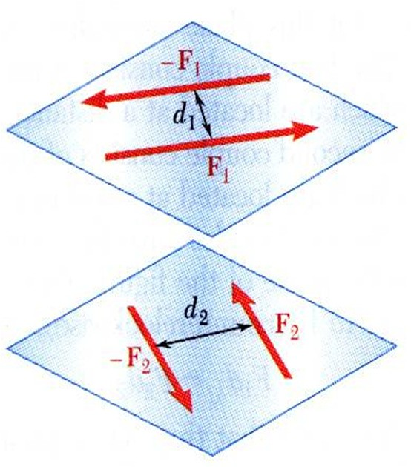
F₁d₁ = F₂d₂
Two couples will have equal moments if
the two couples lie in parallel planes, and
the two couples have the same sense or the tendency to cause rotation in the same direction.

Slide 38
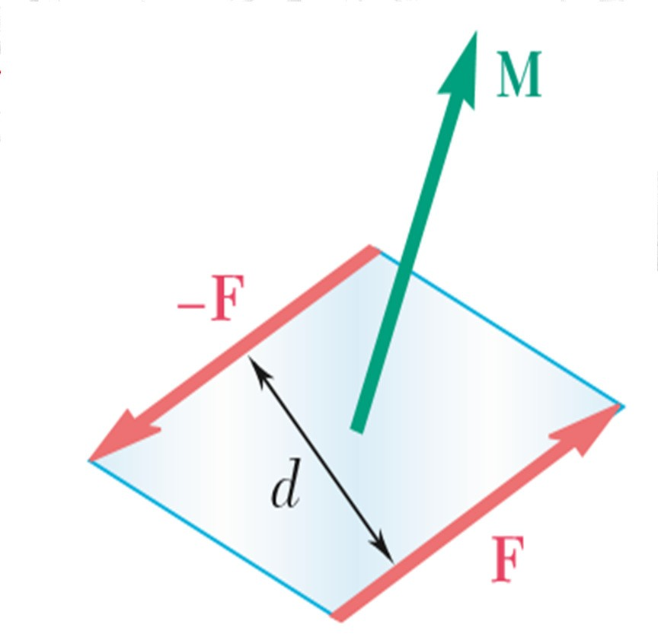
MOMENT Vector OF A COUPLE
The moment vector of the couple is independent of the choice of the origin of the coordinate axes, i.e., it is a free vector that can be applied at any point with the same effect.

Slide 39
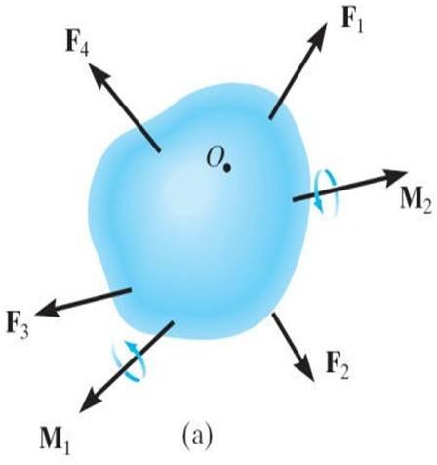
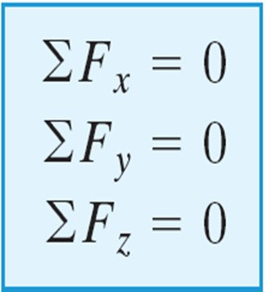

Rigid Body Equilibrium
A rigid body will remain in equilibrium provided
Sum of all the external forces acting on the body is equal to zero, and
Sum of the moments of the external forces about a point is equal to zero
y
z
x

Slide 40
TUTORIAL SHEET

